Slide 1


Slide 2
UMSIT Social Network
Group Members:
Muhammad Yasir 2012-UKIB-14602
Ehsan Ali Rathore 2012-UKIB-14607
Muhammad Sahim 2012-UKIB-14613
Supervisor: Mr. Farooq Akhtar

Slide 3
Contents
Brief Description of System
Software Specification
System Design
Implementation
System Testing

Slide 4
Brief Description
Main purpose of our system is to provide online chat, Status Post, Event Gallery and Event Alert to UMSIT users.

Slide 5
Functional Requirements
User Authentication
Status Post
Like
Comment
Online Chat
Event Gallery
Event Alert

Slide 6
Non-functional Requirements
Ease of use
Efficiency
Security
Maximum time availability

Slide 7
Software Tools
Database Server: MySQL
Development Tools: Microsoft Adobe Dreamweaver cc
Client: Google Chrome
Programming Language: HTML/Java Script/JQuery/PHP/AJAX

Slide 8
System Design
Definition: “Systems design is the process of defining the architecture, modules, interfaces and data for a system to satisfy specified requirements” .
Class Model
Interaction Model

Slide 9
Class Model
Definition: “Capturing real world concepts that are important to an application”.

Slide 10
Class Diagram

Slide 11
Interaction Model
Definition: “It describe interaction between objects.”
Use Case Diagram
Sequence Diagram
Activity Diagram

Slide 12
Use Case Diagram

Slide 13
Description of Use Case Login

Slide 14
Description of Use Case Status

Slide 15
Login Scenario & Sequence Diagram

Slide 16
Login exception Scenario & Sequence Diagram

Slide 17
Picture Upload Scenario & Sequence Diagram

Slide 18
Profile Update Scenario & Sequence Diagram

Slide 19
Activity Diagram for Login

Slide 20
Activity Diagram for Status Post

Slide 21
Activity Diagram for delete status

Slide 22
Activity Diagram for Status update

Slide 23
Implementation
Code:
class status
{
public $posterName;
public $posterId;
public $status;
public $date;
function statusShow($id,$poster,$date,$status,$statusID)
{
?>
<div>
<span>

Slide 24
<a href=chat/profile.php?id=<?php echo $id; ?> style="margin-left: -14px;">
<?php echo $poster; ?>
</a>
</span>
<span style="color:gray; font-weight:normal;" class="col-md-4">
<i style="margin-left:10px">
Posted at:<?php echo $date; ?>
</i>
</span>
<span id="statusText<?php echo $statusID; ?>" >
<?php echo wordwrap($status,50,"<br>\n", true); ?>
</span>
</div>

Slide 25
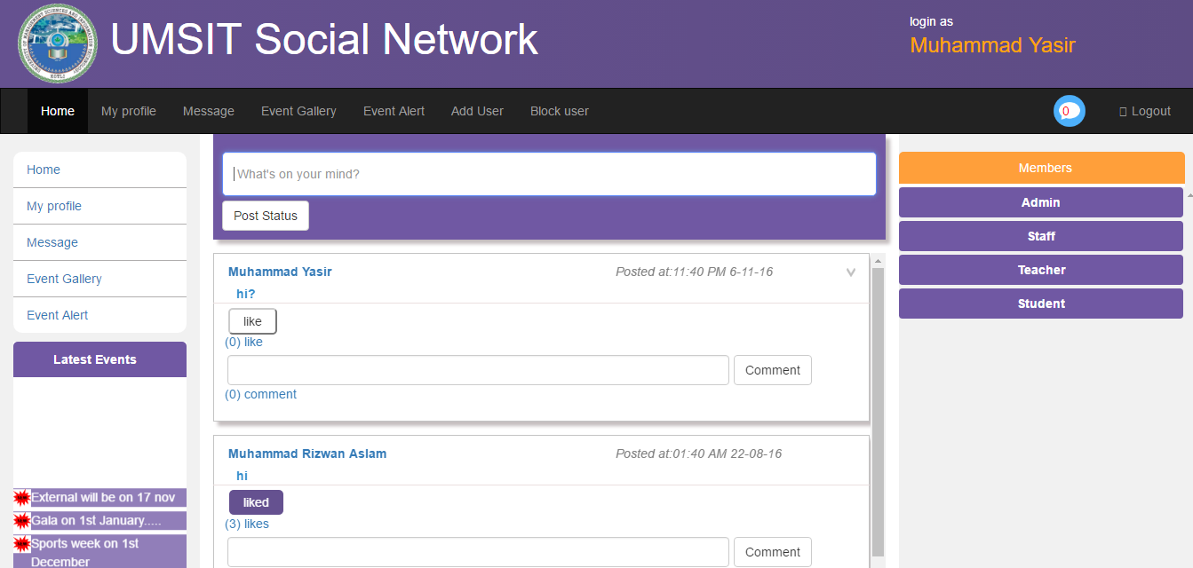
Home page: index.php

Slide 26
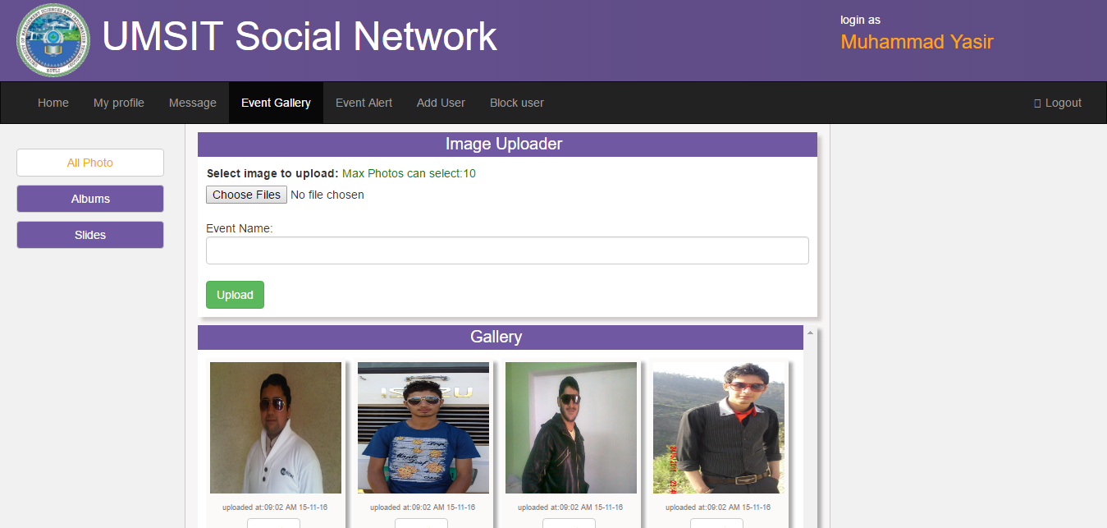
Event Gallery

Slide 27
System Testing
Definition: “The process of performing a variety of tests on a system to explore functionality or to identify problems”
Two Approaches are used for system testing
White Box testing
Black Box testing

Slide 28
Test case: Status Insert
ID | 01
Name | Insert Status
Brief Description | Used to Insert Status
Expected Input | Status(text)
Expected flow of Events | Insert and display the Status
Alternate flow of Events | User Quits
Pre-Condition | Status exist
Post Condition | Status Inserted
Actor | Administrator, Teacher, Staff, Student
Status | Pass

Slide 29
Test case: upload profile picture
ID | 02
Name | Picture upload
Brief Description | Used to upload Picture
Expected Input | Picture, Event name
Expected flow of Events | Profile picture uploaded
Alternate flow of Events | User Quits to upload profile picture
Pre-Condition | Profile exist
Post Condition | Profile Picture uploaded
Actor | Admin, Student, Teacher, Staff
Status | Pass

Slide 30
Thank you

